Slide 1
Retention and Turnover of Teachers in Alaska: Why it Matters
Diane Hirshberg
Professor of Education Policy
UAA Center for Alaska Education Policy Research at ISER
Notes:
This morning I want to tell one story about the teaching workforce in Alaska, focusing on who stays or leaves, what it costs when a teacher leaves, and why some teachers decide to leave.
CAEPR and ISER have looked at issues around teacher supply, demand and turnover for a couple of decades…

Slide 2
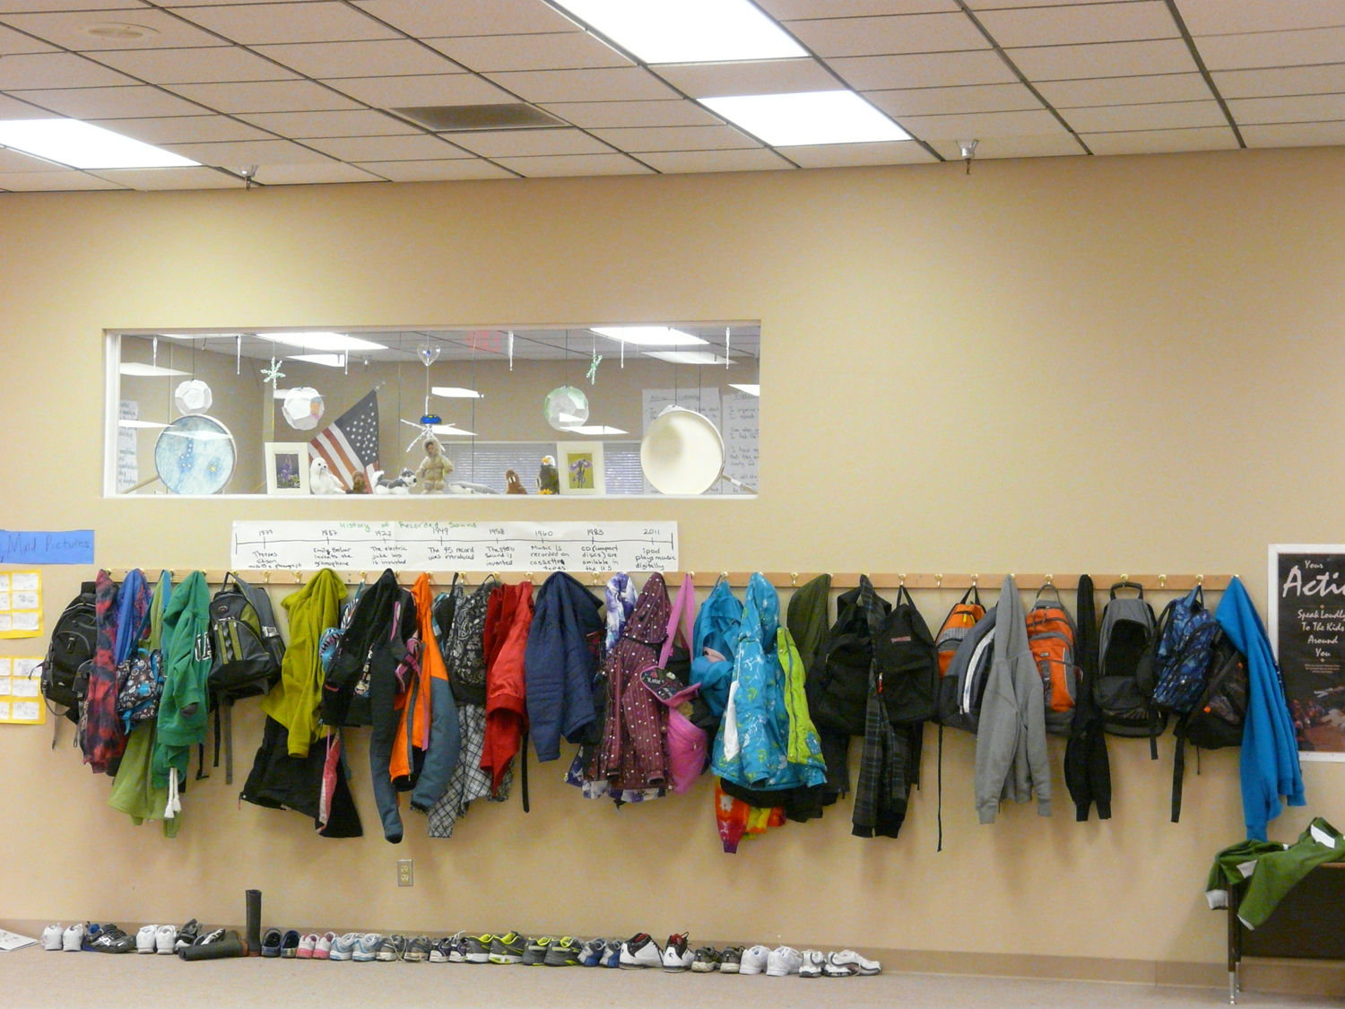
Notes:
This morning I want to tell one story about the teaching workforce in Alaska, focusing on who stays or leaves, what it costs when a teacher leaves, and why some teachers decide to leave.
– we need to be thinking of how we are going to provide our youth with the best possible education in the face of difficult fiscal times, and understanding how we can keep good teachers is a big part of this.

Slide 3
Notes:
Many of you will have seen these first few slides already – but it’s something to remember – in our rural districts we tend to have turnover rates that are very high.

Slide 4
Turnover adds up over time…
Notes:
12 districts lost 2/3 or more of their teachers over 5 years

Slide 5
In Alaska high teacher turnover correlated with poor student achievement
 | Average Teacher Turnover | Average Percent of students scoring proficient in Reading
5 Lowest Turnover Districts | 8.7% | 85.8%
5 Highest Turnover Districts | 37.9% | 46.9%

Slide 6
Recruiting/replacing teachers
Just under 7,900 full & part-time teachers in Alaska public schools
On average 800 teachers recruited each year from outside
Fewer than 300 teacher prepared each year in the UA system
Not all go into teaching right away
Majority work in the big 5 districts
Number of UA Awards by Initial Teacher Programs
FY | 2013 | 2014 | 2015 | 2016 | 2017 | 2018
UA | 233 | 263 | 235 | 210 | 248 | 278

Slide 7
Turnover Among Teachers Prepared in Alaska and Outside, by Years of Experience, Average 2007-2012

Slide 8
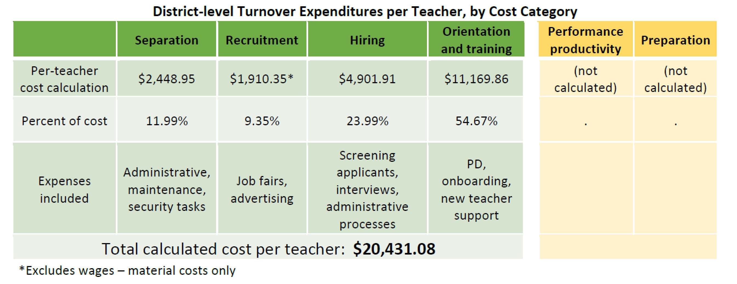
Cost of teacher turnover

Slide 9
Cost of teacher turnover…
Overall teacher turnover costs the state at least $20 million/year
Schools with higher turnover invest disproportionate resources in replacing teachers who leave.
Costs are higher in rural communities.
Administrative costs, conservative estimate
Cost of Teacher Turnover in Alaska (2017)
Notes:
Cost of Teacher Turnover in Alaska (2017)
https://iseralaska.org/publications/?id=1634

Slide 10
Cost of teacher turnover
Actual costs of teacher turnover likely higher than estimated
Not all turnover is bad
Retention pays off
Notes:
Our cost estimates are conservative. Wevestimated the average weighted cost of teacher turnover in four specific cost categories. We did not estimate the
additional costs districts face, if teachers leave mid-year, or the costs to Alaska, related to teacher preparation
and reduced student achievement. But even our conservative estimates show that the direct costs of high teacher
turnover are significant. If school districts could reduce turnover, they would have more money to invest in
teaching and learning.
•Not all turnover is bad, nor are all turnover costs. districts can’t expect to eliminate all
teacher turnover. Some turnover is in fact beneficial—teachers leave the profession if it is not a good fit for them;
some take other jobs in education; and some retire, indicating stability. And while mentoring and induction
activities for new teachers are costly up front, they promote effective teaching and help keep teachers in the
classroom—reducing costs in the long-run.
• Retention pays off. Retaining teachers over time not only improves the quality of instruction, but reduces direct
turnover costs—allowing districts to reallocate money to teaching and learning

Slide 11
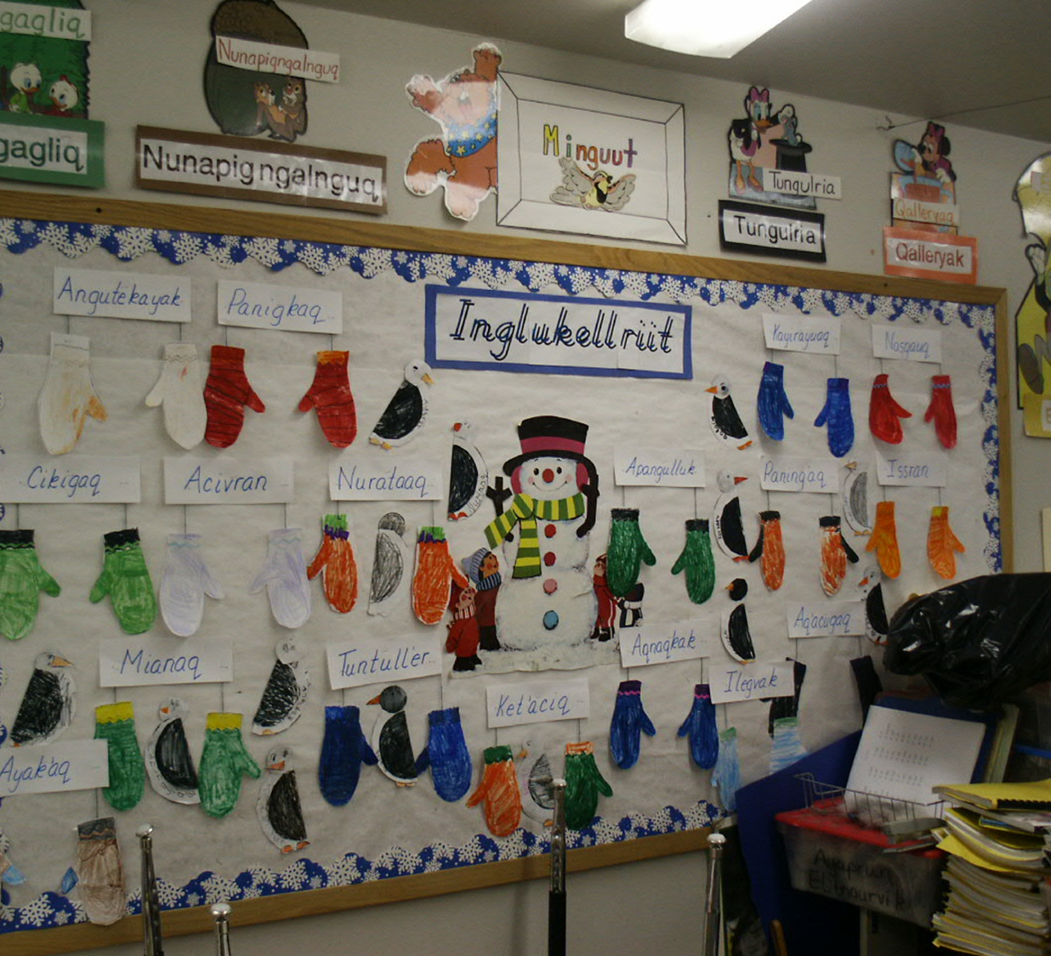
Why are teachers leaving?
Notes:
How do we stem teacher turnover? First, we need to understand *why* teachers are leaving
High turnover needs to be stemmed
Pay is a part of the equation, but…
Working conditions more important
Parent/community support
Administrative support
Sense that succeeding with students
Induction, mentoring & professional development important

Slide 12
Alaska teacher salaries…
…are about 15% below where they should be (statewide).
Salary needed to attract and retain high quality teachers varies significantly by community and depends heavily on working conditions there.
There is a 116% difference between lowest and highest recommended salaries.
Salary & Benefits Schedule and Teacher Tenure Study (2015)
Notes:
Salary & Benefits Schedule and Teacher Tenure Study (2015)
https://iseralaska.org/publications/?id=1584

Slide 13
Teacher turnover…
…cannot be “fixed” with salary alone.
Compensation matters, but working conditions are a bigger factor in teacher turnover decisions than pay.
It’s more than just dollars: Problematizing salary as the sole mechanism
for recruiting and retaining teachers in rural Alaska (2018)
Notes:
It’s more than just dollars: Problematizing salary as the sole mechanism for recruiting and retaining teachers in rural Alaska (2018)
https://iseralaska.org/publications/?id=1701

Slide 14
Statewide Survey of Teachers
Initial round N=290
Response Rate = 29%
17 rural districts
111 Elementary
89 Secondary
73 Both
Matched with what actually did

Slide 15
How satisfied are you with each of these aspects of your current job?
Percent DISSATISFIED
Notes:
No difference: Salary, Health Benefits, Retirement Benefits, Teacher Workload, School Facilities

Slide 16
Administration
Percent DISAGREE
Notes:
Nothing borderline here; no difference in: facilitates using data to improve student learning; . consistently supports teachers; respected by the community; Teachers are held to high professional standards; Administrators and teachers have a shared vision about student discipline; There is an atmosphere of trust and mutual respect in this school.

Slide 17
Community Support for School
Percent DISAGREE
Notes:
Areas the same: 6.4.1 Parents/guardians are influential decision makers in this school. 8.1.11 Families are involved and supportive of the school.

Slide 18
What can we do?
Grow more of our own
Too few teachers home grown, from rural and/or Indigenous backgrounds; < 5% teachers are Alaska Native
ncourage youth in your communities to go to college
Ask current teachers to mentor students
Pay for H.S. graduates to get a teaching degree (e.g., LKSD)/take advantage of loan forgiveness (state Teacher Education Loan)
Raise the status of teachers in your community – make it a desired profession
Find out why teachers in your districts might be leaving… address issues that you can affect…
Notes:
In many of your villages, teachers from outside can’t actually become a permanent member of the community; because they are not members of the local tribe, they cannot buy a house or participate in community decision-making. Is the solution changing the law? No – I’d argue it’s finding a way to get young people in our villages to want to become teachers. Fewer than 5 % of certificated educators across the state are Alaska native. This varies by community – some districts like the Lower Kuskokwim School District, have made a concerted effort to encourage local residents to become teachers, investing in them. There are efforts to deliver teacher education in rural communities, such as Chevak. But the numbers of people in these programs are quite small. We just did a study of distance teacher education efforts in the University of Alaska system over the past 30 years, and these programs such as XCED and the Rural Educator Preparation Program only graduated a couple hundred teachers. We need to prepare hundreds of Alaska Native and rural teachers, and we’re not doing it.
And we’ve got a vicious cycle here – if students are graduating unprepared for college, they are going to be discouraged and not complete it.
Or, we may not be sending the best and brightest into our schools – I think we all know bright young Alaskans who have studied to be a teacher only to be offered a more lucrative and prestigious job in another organization, whether a Native corporation or another private sector position.

Slide 19
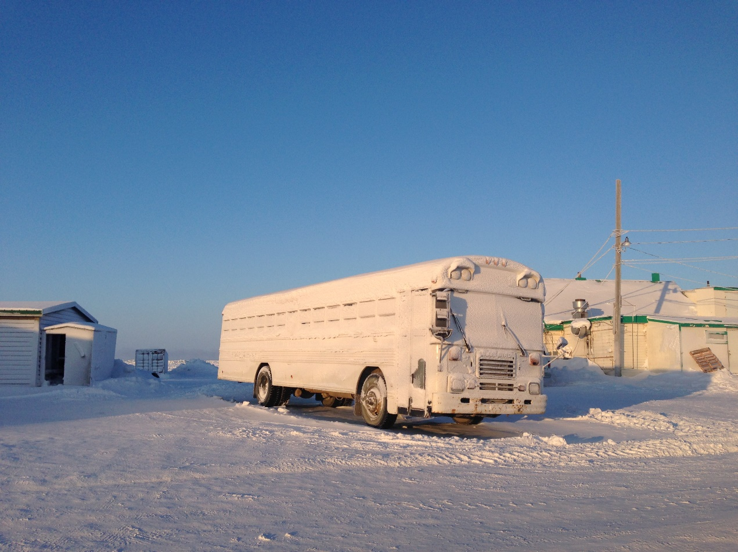
Questions?
Contact:
Diane Hirshberg
dbhirshberg@alaska.edu

